Slide 1

Bank System
AbdulMohsen
Nawaf
Abdullah
Saad
Tareq
Rayan

Slide 2

What is Bank
A bank is a financial institution that accepts deposits from the public and make withdraw operation from specific account , bank system also allow the user to transfer money from account to another account after insure that the two accounts are belong to this bank

Slide 3

Why WE use Files?
A DataBase is an organized collection of data or information , typically stored electronically in a computer disk ( secondary store not temporary store ). We can divide database to many types .

Slide 4

Database
database
Structured
UnStructured
mysql
Files

Slide 5

Why WE use Files?
When a program is terminated, the entire data is lost. Storing in a file will preserve your data even if the program terminates

Slide 6

About our program
our Project is bank system which has been written using java language , the data has been stored into txt file .the program allow user to do main operation of any physical bank like create account , edit specific account information , make some transaction on many as deposit and so on …
The program contain many classes , and it deal with main customer data like his name , age , balance and account number .

Slide 7

Main classes in the program
BankAccount Class
Current class
Account Class

Slide 8

Back Account class also contain :
Setter methods ( one for each variable)
Getter methods (one for each variable)
Abstract methods ( addMony method which used in deposit operation and withdraw operation with used in withdraw transaction and in transfer operation )

Slide 9
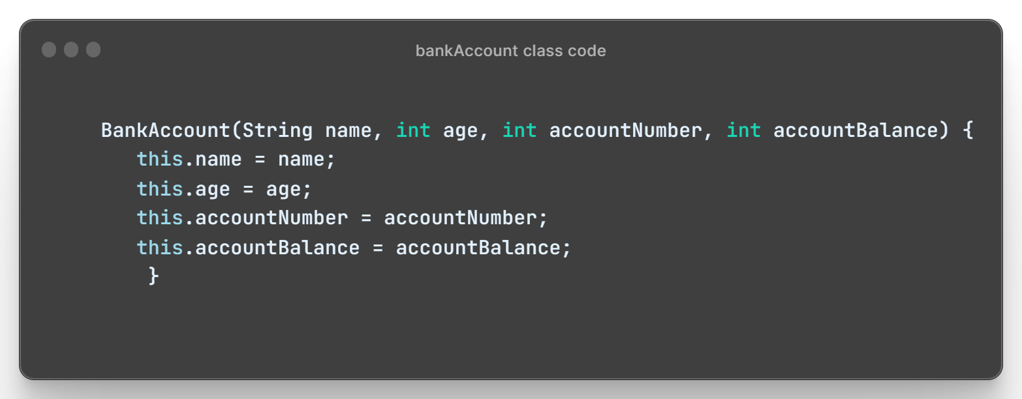
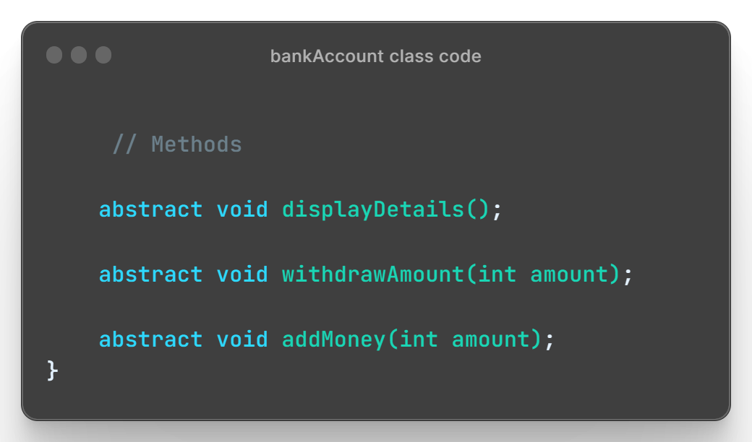
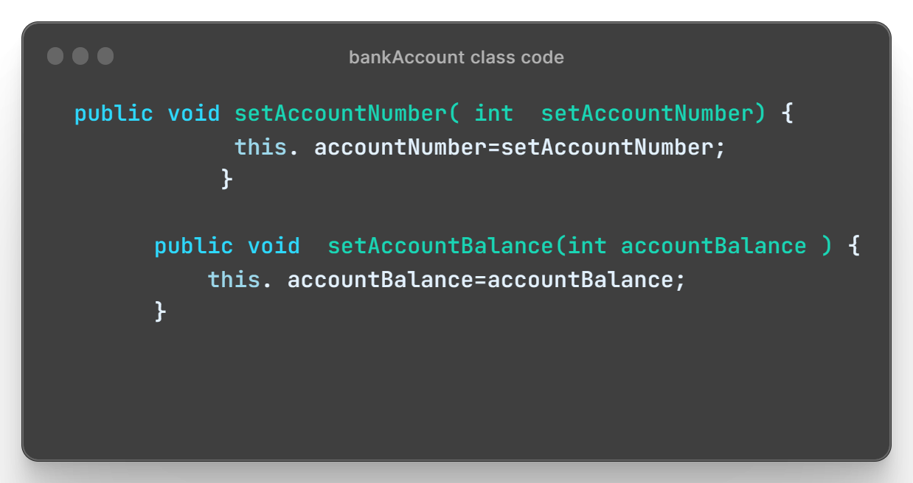
ScreenShut of bank Account class code

Slide 10
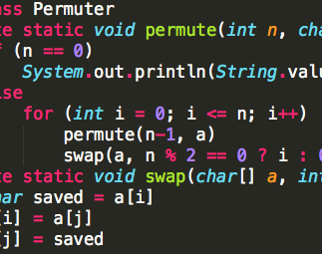
Current class( child class )
This class inherited parent class ( bank Account class) so it contain supper method inside its constructors to call the parent constructors , it also contain the implementation of add Mony method and the withdraw method because the have abstract declaration in the parent class .

Slide 11
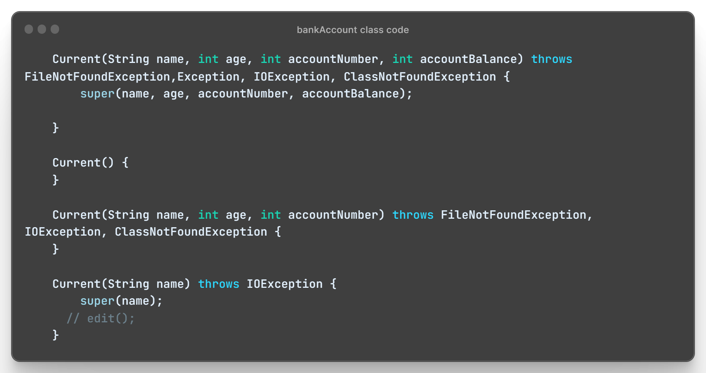
ScreenShot of Current class code

Slide 12
Account Class
This class contain a lot of method that implement the previous classes and do the operation on a specific file , also contain the main method .
The account class implement serializable interface

Slide 13
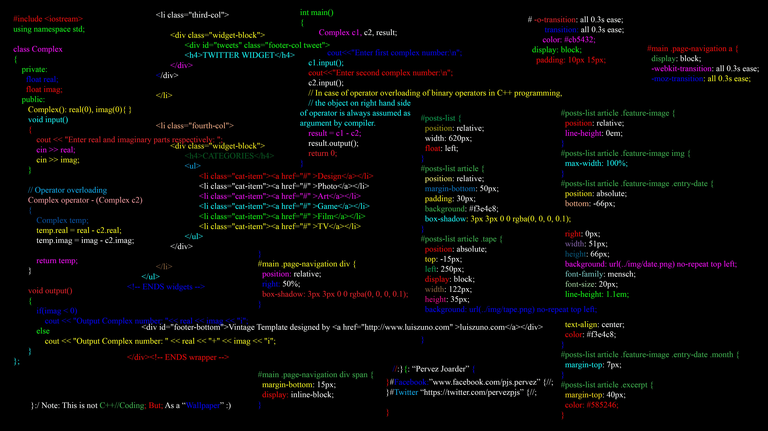
Why did we implement serializable interface in out program
Implement the Serializable interface when you want to be able to convert an instance of a class into a series of bytes to be ready to write on files

Slide 14
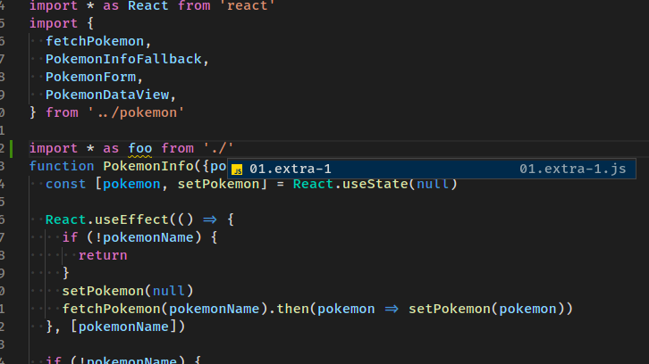
Account class method
When we run the main method we create account object , this object allow us to call all the method inside this class , the constructor make initialize to the variable (insure that the file is exist , copy the file content into array List
After we have initialize the arrayList then we can make all operation on it , add elements to it ( arrayList with current class object ) means each added element is new account , edit element inside it after searching about this element by using its account number and retrieve object properties using get methods
This Photo by Unknown Author is licensed under CC BY-SA

Slide 15
At runtime of program
Available choices
Choices that read from file
Choices that write to file
When we run the program (by run account class file because it is contain main method) many choices available to the user we can divide then into two categories

Slide 16
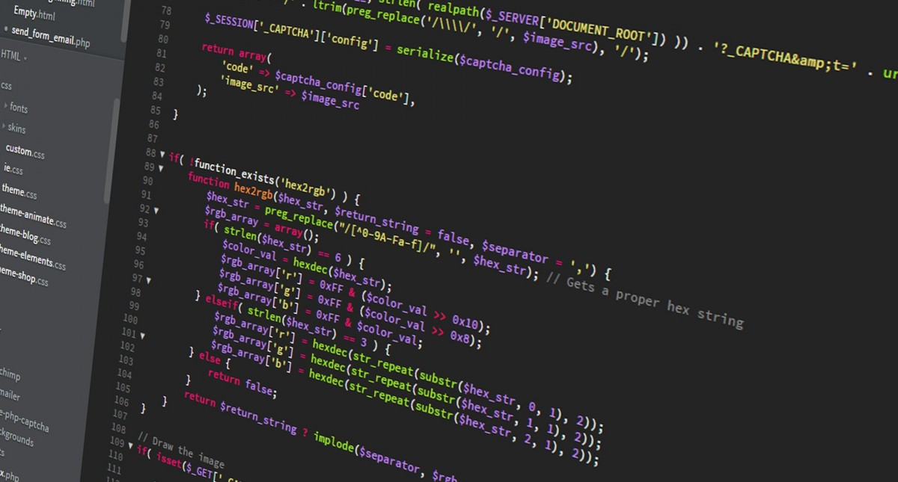
Available choices
Choices that read from file
Display accounts details
Search about specific account
Choices that write on file
Add account or many
Edit account information
Delete specific account
Deposit
Withdraw
Transfer

Slide 17
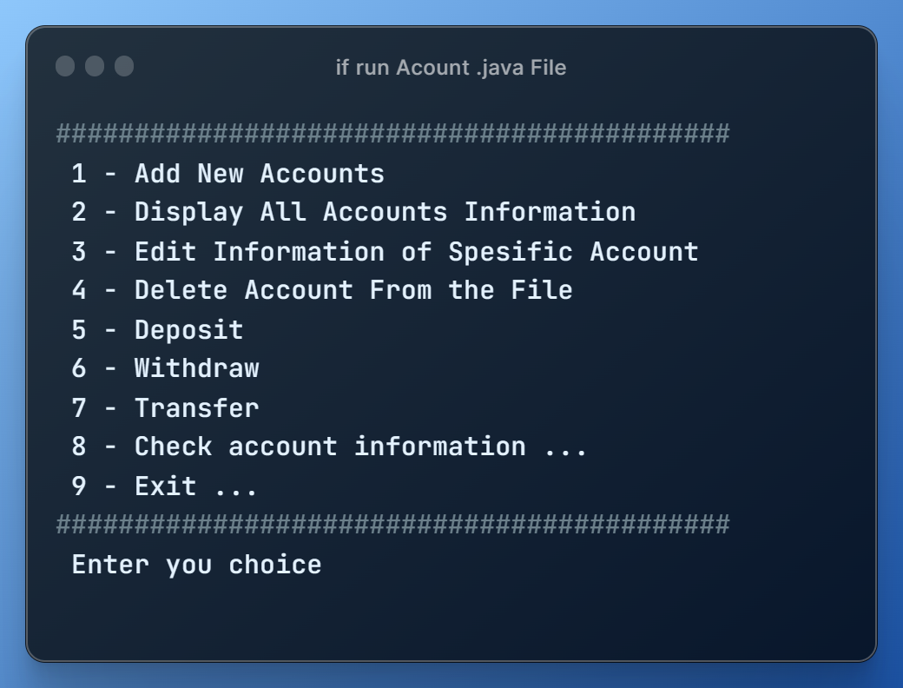
If Run Acount java file this outbot

Slide 18
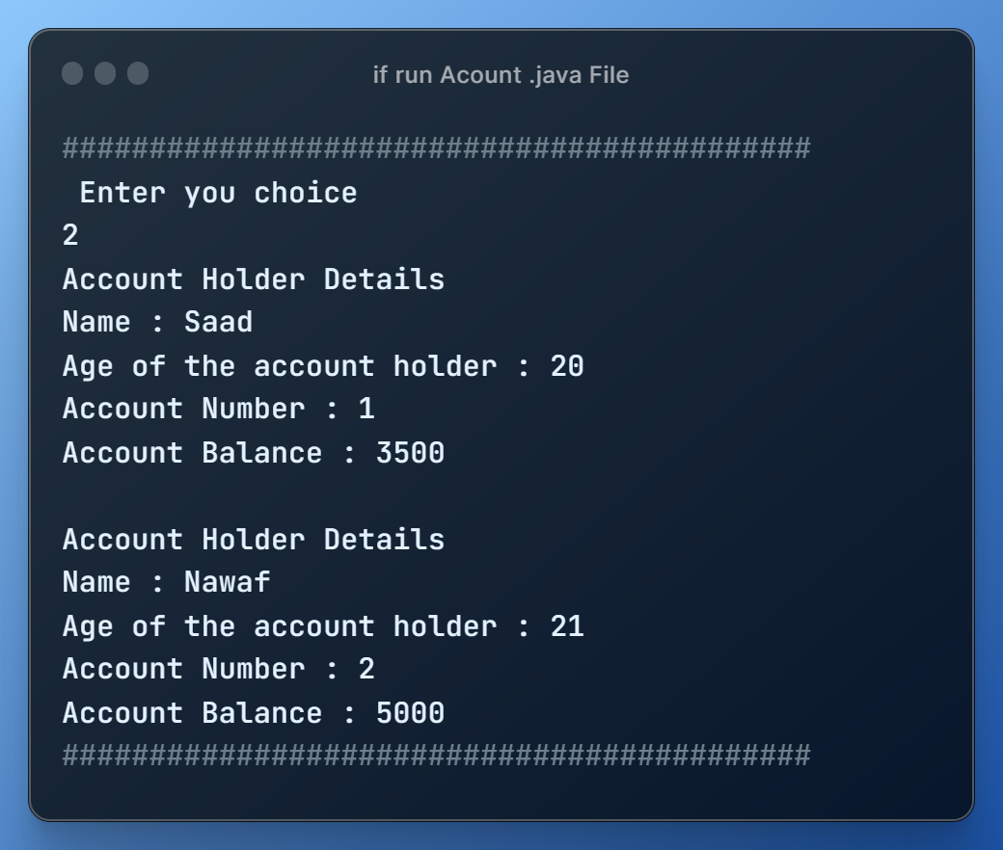
For Example : Choice 7 ( Transfer )
Accounts balance before transfer operation

Slide 19
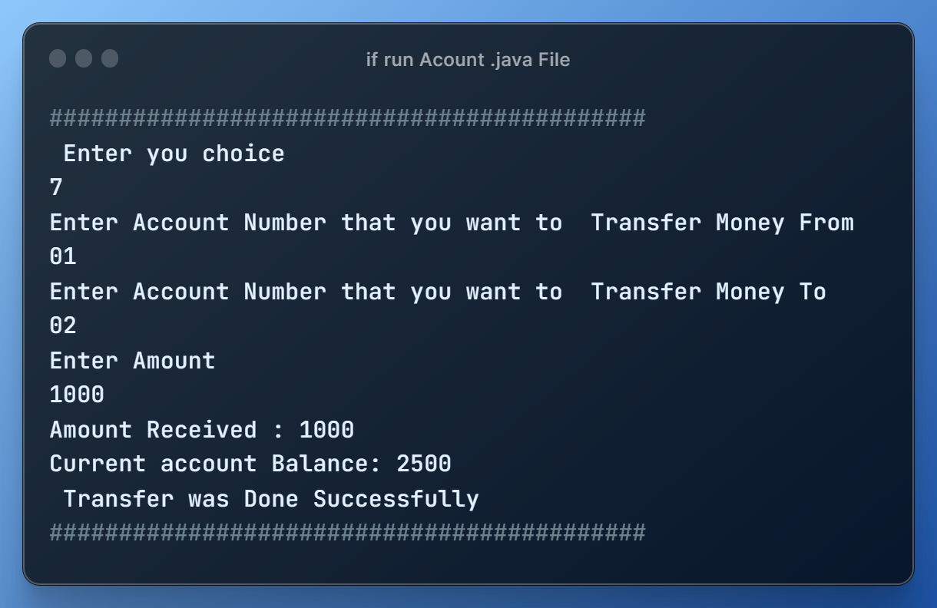
For Example : Choice 7 ( Transfer )

Slide 20
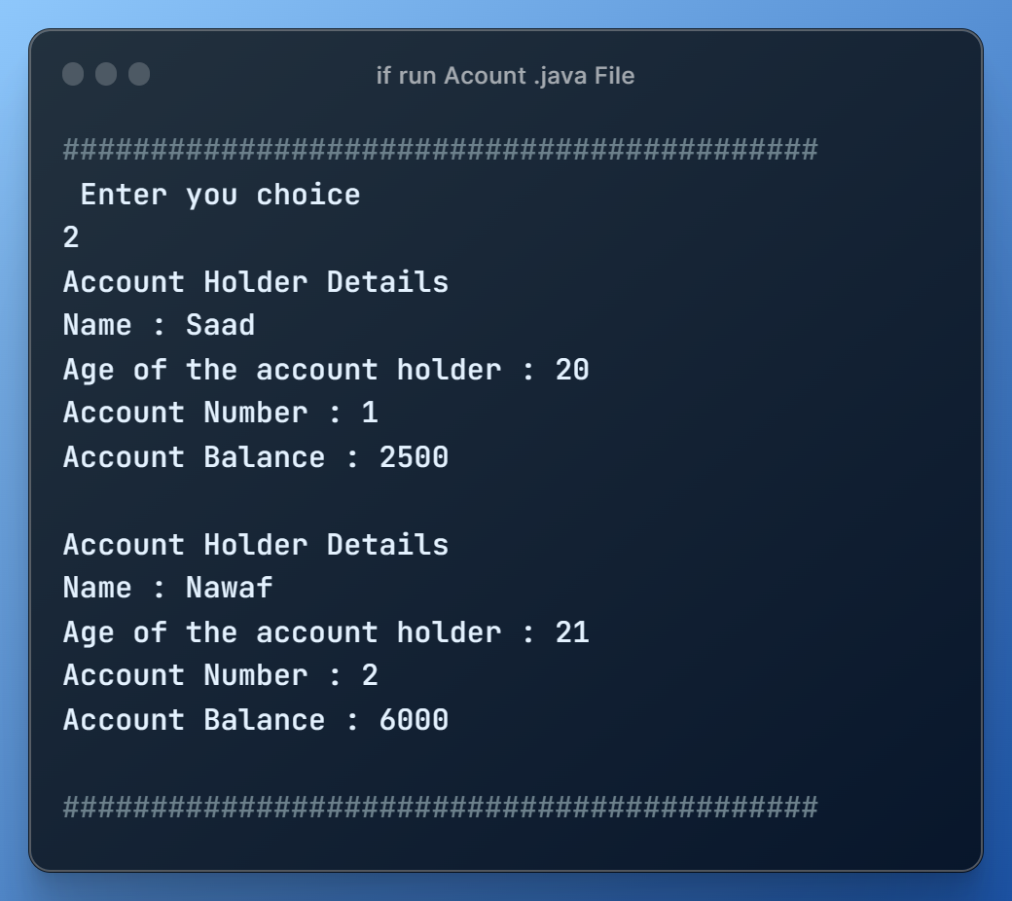
For Example : Choice 7 ( Transfer )
Accounts balance after transfer operation

